Slide 1


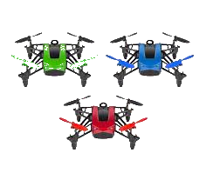
DEMO
Group 32
FAU CS & CE EGN 4952C
Group 32: Tutku Gizem Guder
Brenden Martins Matthew Paternoster Matthew Wyatt Tarek Kayali
Multiple Drones Coordination

Slide 2
Introduction - Multiple Drone Coordination System
Multiple Drones Coordination
FAU CS & CE EGN 4952C
Group 32
Project Objectives
Our objective is to develop a system for coordinating multiple drones in a realistic 3D simulation environment, which is in response to the growing challenges current emergency response systems face in disaster ridden areas.
Challenges
These challenges include, but are not limited to, human safety risks, limited drone coordination systems, and inefficient testing environments for the drones. We plan to address these challenges by providing a scalable and efficient MDCS, which can increase the positive outcomes for areas that are facing disaster scenarios.

Slide 3
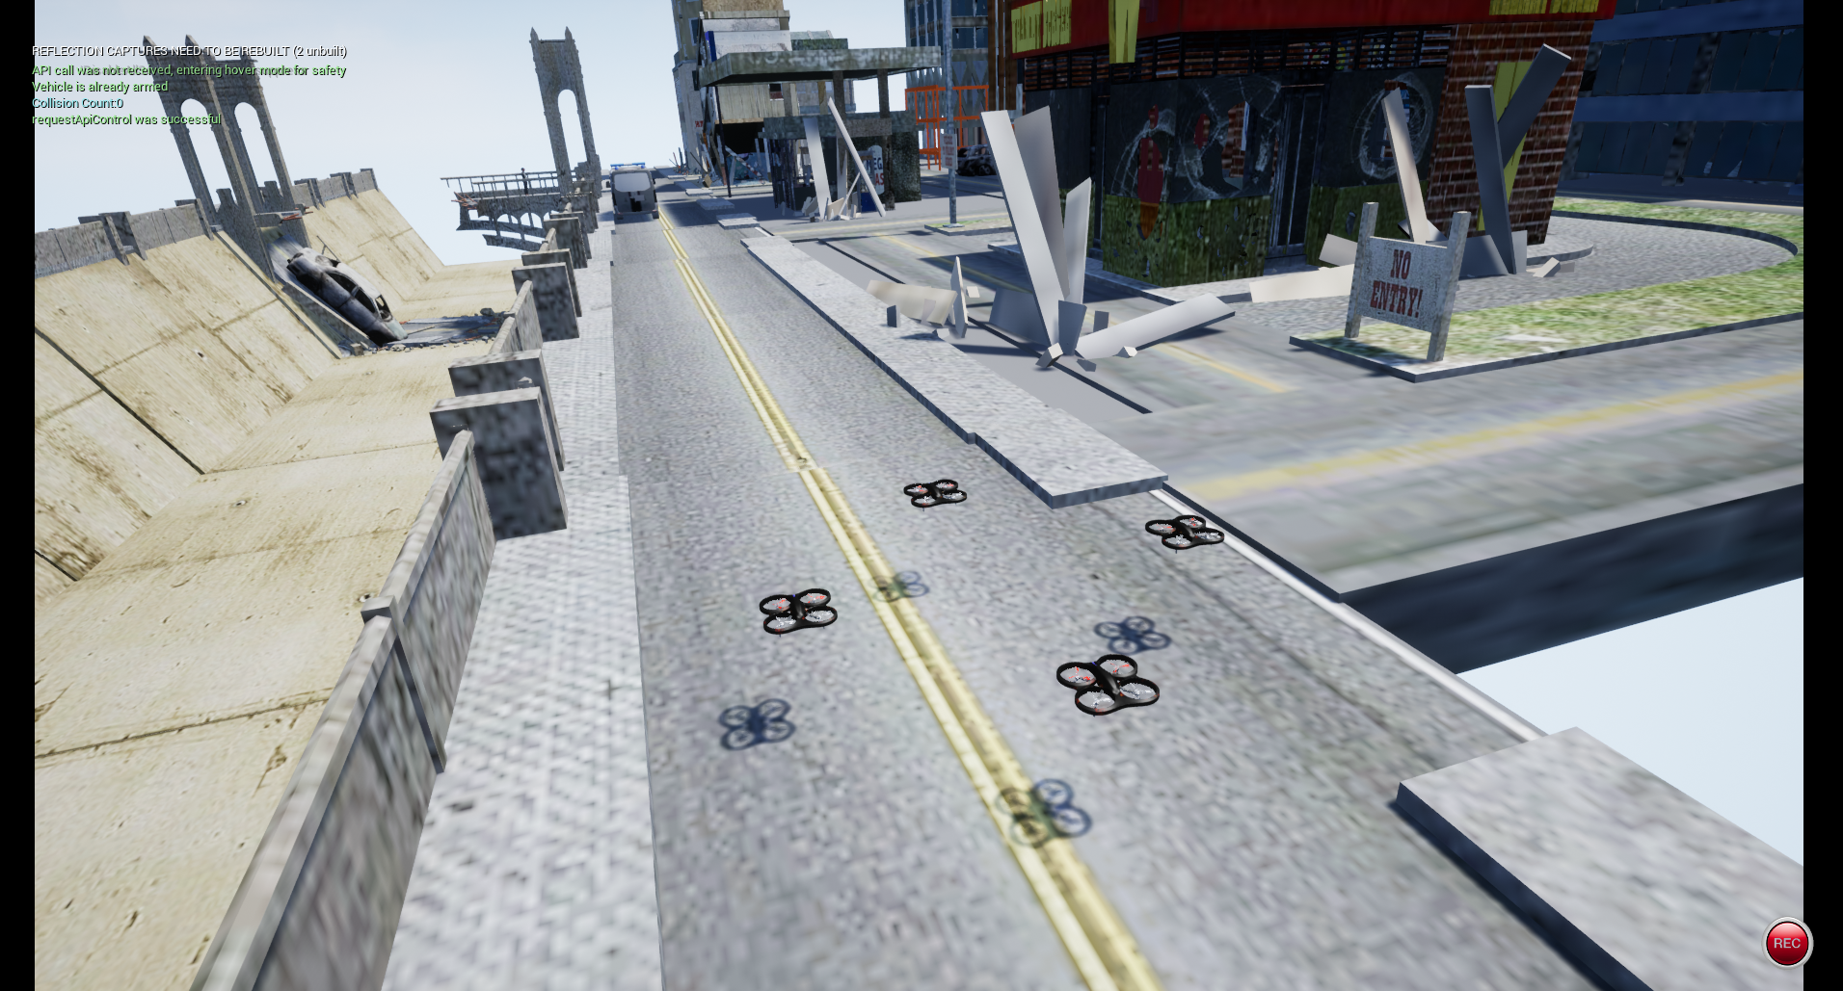
Proposed Solution
Multiple Drones Coordination
FAU CS & CE EGN 4952C
Group 32
Our Project aims to solve some of these challenges by developing a system for coordinating multiple drones in realistic simulated environment to carry out tasks like target detection and path planning.

Slide 4
Project Implementation (3D Simulation Subsystem)
Multiple Drones Coordination
FAU CS & CE EGN 4952C
Group 32
Configured AirSim plugin inside Unreal Engine 4.27 for multi-drone support
Designed and optimized a realistic 3D disaster environment (terrain, buildings, weather)
Mapped collision boundaries to prevent unintended crashes
Implemented dynamic weather systems (rain, fog, snow) for realism
Developed Python scripts for:
Drone spawn positioning
Takeoff, hover, and waypoint navigation
Integrated multi-drone operation with synchronized takeoff and movement
Focused on creating a stable, scalable simulation platform for future testing and integration

Slide 5

Project Goals
Multiple Drones Coordination
FAU CS & CE EGN 4952C
Group 32
Matthew Paternoster
Develop a multi-drone coordination system in a 3D environment to improve disaster response.
Enhance real-time victim detection and hazard monitoring.
Build and test a realistic 3D simulation with Microsoft AirSim.
Provide an operator UI for mission planning, live telemetry, and video feed
Ensure safe operations with collision-avoidance and status monitoring

Slide 6
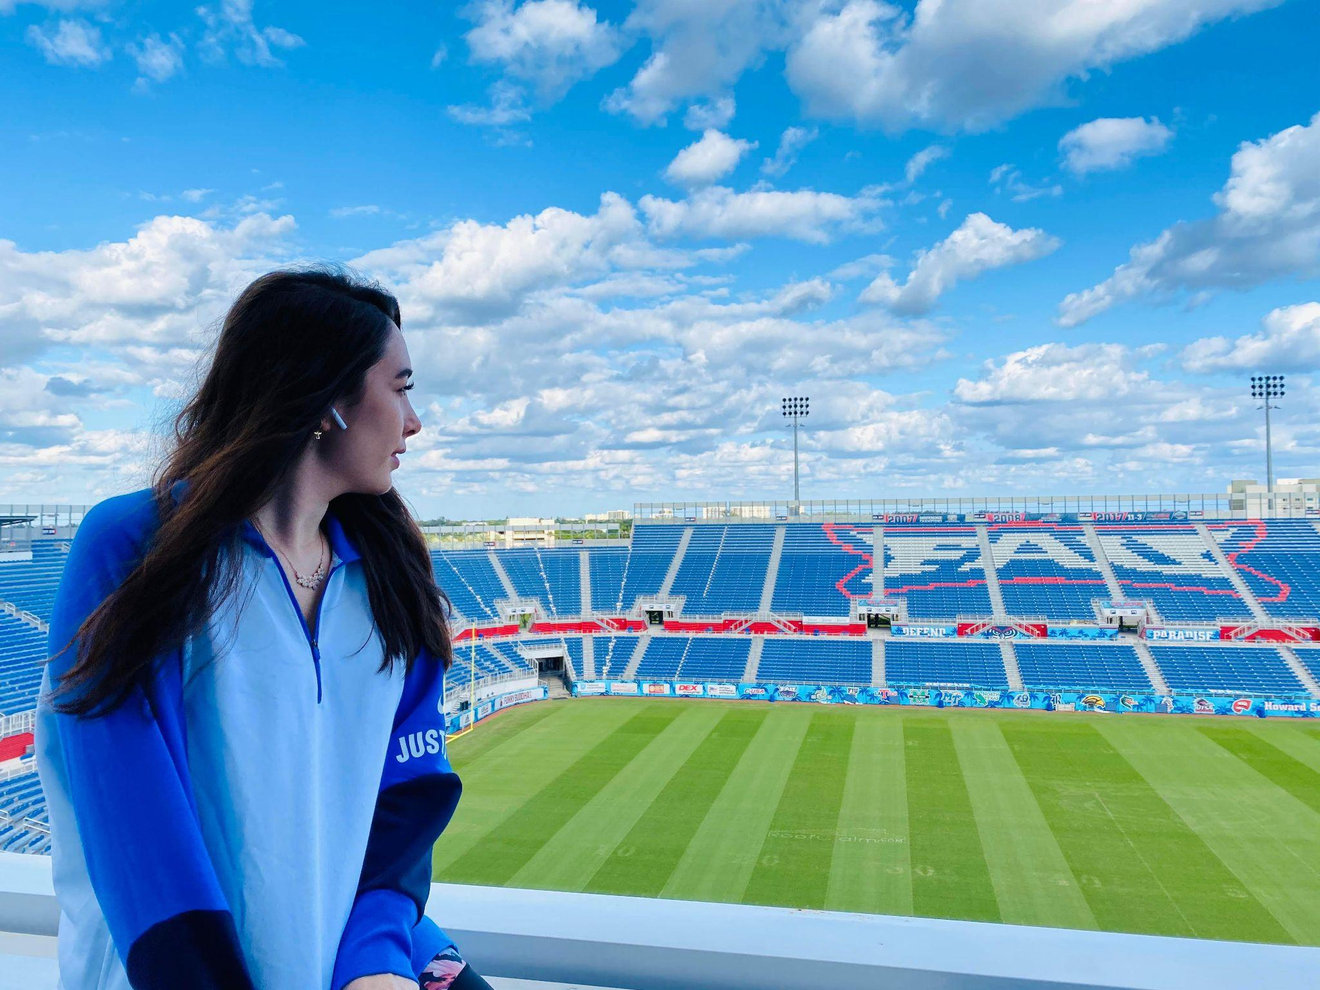
Project Requirements-Hardware
Multiple Drones Coordination
FAU CS & CE EGN 4952C
Group 32
We rely on a high-performance workstation with multi-core processors and a high-end GPU to support real-time 3D drone simulations and physics rendering ​. A stable Wi-Fi network is used to emulate communication links between drones and the control interface

Slide 7
Project Requirements-Software
Multiple Drones Coordination
FAU CS & CE EGN 4952C
Group 32
Our implementation uses Python for scripting, and JavaScript for the web-based UI ​. Key frameworks include the AirSim API for simulation control, ROS 2 for low-latency messaging, PostgreSQL for telemetry and mission data storage.

Slide 8
Project Design-System Architecture
Multiple Drones Coordination
FAU CS & CE EGN 4952C
Group 32
MDCS comprises six modular subsystems—Drone Control, Communication, User Interface, Simulation Management, Target Detection, and Data Management—linked via a unified block-diagram architecture. It operates entirely in a 3D AirSim/Unreal Engine simulation, facilitating dynamic terrain, weather, and scenario testing without hardware risk.

Slide 9
Project Design-Core Functionalities
Multiple Drones Coordination
FAU CS & CE EGN 4952C
Group 32
The Drone Control Subsystem orchestrates synchronized search patterns, RRT- and potential-field-based collision avoidance, and emergency safe-landing protocols, while the Communication Subsystem uses ROS 2 over Wi-Fi for low-latency messaging ​. Target Detection uses the camera system and the distance detection for real-time object classification.

Slide 10

Project Testing and Evaluation
Multiple Drones Coordination
FAU CS & CE EGN 4952C
Group 32
Tarek Kayali
• Tested drone navigation under different weather conditions
• Validated collision avoidance during multi-drone operations
• Measured object detection accuracy and communication delays
• Recorded mission success rates across simulated disaster scenarios
• Identified areas for future optimization (e.g., scalability)

Slide 11
Discussion & Lessons Learned
Multiple Drones Coordination
FAU CS & CE EGN 4952C
Group 32
Matthew Paternoster
Biggest win: end-to-end integration of AirSim → Flask → React, never done a project this large before
Key challenge: version compatibility across AirSim, Unreal, Python libraries
Next steps: fix live-feed encoding, add map-based mission planning, secure comms for real drones
Takeaway: seeding randomness + sync mode makes demos rock-solid and repeatable

Slide 12
Discussion & Lessons Learned (cont.)
Multiple Drones Coordination
FAU CS & CE EGN 4952C
Group 32
Complexity of System Integration
Managing real-time simulation across multiple drones and subsystems
Challenges with AirSim and Unreal Engine
Plugin compatibility, environment stability, and drone control issues
Importance of Modular Design
Easier troubleshooting and future scalability
Critical Role of Communication and Documentation
Needed for subsystem coordination and smooth integration

Slide 13
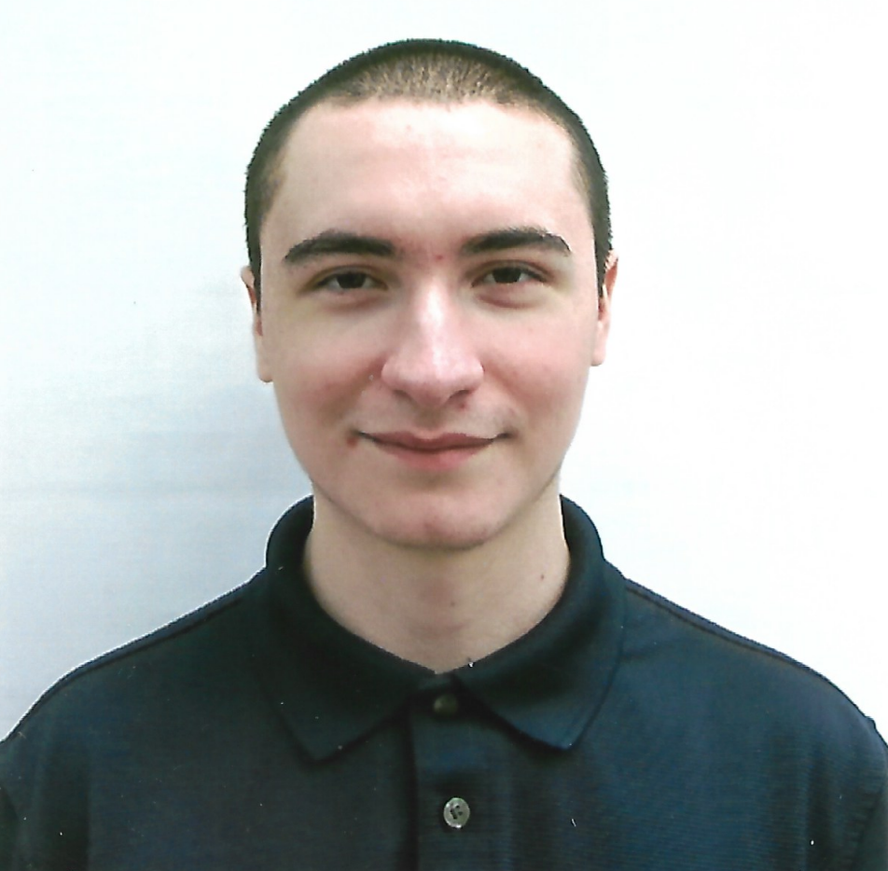
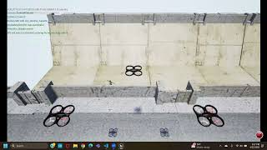
Project Demonstration
Multiple Drones Coordination
FAU CS & CE EGN 4952C
Matthew Wyatt + Brenden Martins

